Slide 1
Automatic Flutter Code Generation using Sketch UI Mockups
Prince Hodonou
Aakash Madabhushi

Slide 2
Problem Statement
In modern software engineering, applications are getting more and more complex. Client demands to build and deploy apps due quickly are increasing tremendously. Yet with this increase of demand in software applications, the development process is stagnate. Development process is usually a two-fold problem: 1. Developing a sketch mockup 2. Implementing that sketch mockup along with its respective logic.
As this problem is challenging and time consuming, we present Widget Detector which automates the process of converting sketch mockups through object detection to Flutter UI components using deep learning image classification.
Object detection is a computer vision technique that allows us to identify and locate objects within the image.

Slide 3
Proposed Solution
Implemented a two branch neural network, one for bounding box regression and one for widget label classification. We utilized transfer learning through the VGG16 pretrained network on ImageNet and added our two branch network on top of it.

Slide 4
Implementation Details
Data Pre-processing:
During this phase, we started converting widget class labels using the LabelBinarizer which assigns a unique value to each label in a categorical feature and the bounding box will be assigned binary value (0,1) since it’s easier for the model to be able to predict values in a fixed range for each image.
Next, we split the csv file into the image_name, label, x1, y1, x2, y2, w and h.
After which, we would need to normalize the bounding box coordinates (x1,y1,x2,y2) before storing them to the list
Then we would call keras to load the images and convert each of them to array before storing them to the list.
Using the VGG16 model preprocess_input() function, this changes the images to the format that is compatible with the model.
The label binarizer is used to fit and transform the array of labels to binary labels.

Slide 5
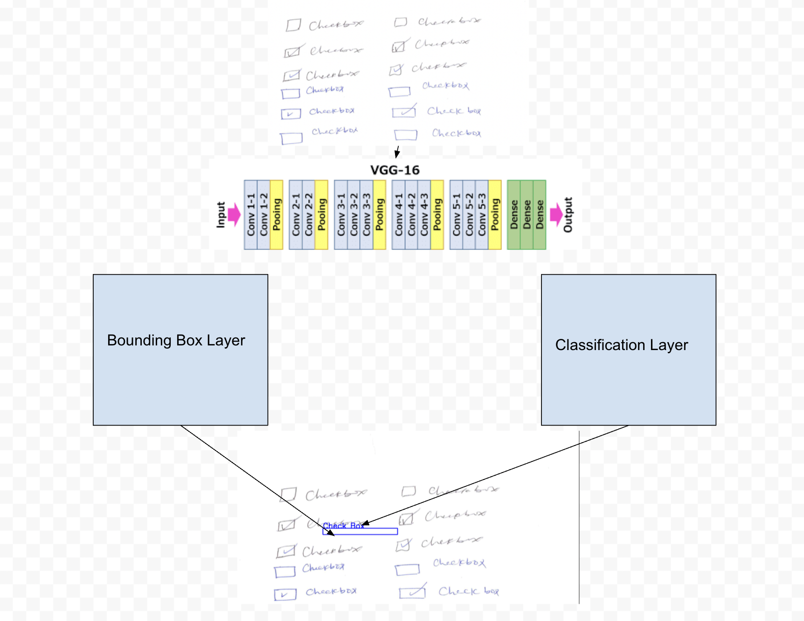

Slide 6


Slide 7
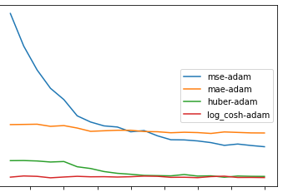
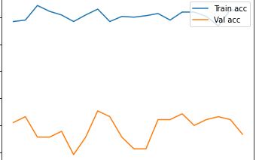
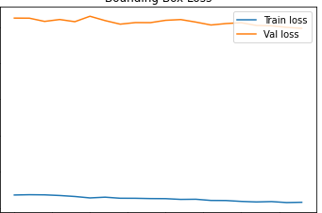
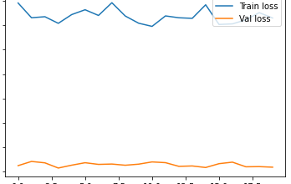
Results & Discussion

Slide 8
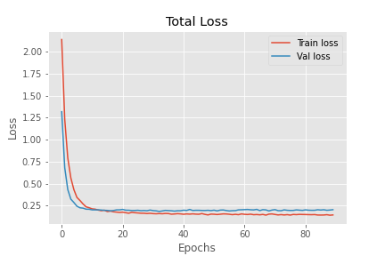

Slide 9
Conclusion
We have implemented automation of translating hand draw sketches to code with the use of deep learning by classifying and predicting user interface components and generating appropriate code for that component.
If implemented fully, this can be used to greatly speed up the app development process. It can also be used as a teaching tool. To accomplish our task, we designed a two branch neural network, one for bounding box regression and one for widget label classification.
We utilized transfer learning through the VGG16 pretrained network on ImageNet and added our two branch network on top of it. Our architecture proved to give promising results for the future with an average widget component classification of 97% and an average bounding box regression of 60%.

Slide 10
References
Automatic code generation from sketches of mobile applications in end-user development using Deep Learning - Daniel Baulé1 , Christiane Gresse von Wangenheim1 , Aldo von Wangenheim1 , Jean C. R. Hauck1 , Edson C. Vargas Júnior2 https://arxiv.org/pdf/2103.05704v1.pdf
pix2code: Generating Code from a Graphical User Interface Screenshot - Tony Beltramelli UIzard Technologies Copenhagen, Denmark tony@uizard.io https://arxiv.org/pdf/1705.07962.pdf
sketch2code: Generating a website from a paper mockup - Alexander Robinson University of Bristol ar15247@bristol.ac.uk
YOLO v3 Object Detection with Keras - https://towardsdatascience.com/yolo-v3-object-detection-with-keras-461d2cfccef6
You Only Look Once: Unified, Real-Time Object Detection - https://arxiv.org/pdf/1506.02640.pdf
Bounding Box - https://d2l.ai/chapter_computer-vision/bounding-box.html
Going Deeper with Convolutions -https://static.googleusercontent.com/media/research.google.com/en//pubs/archive/43022.pdf
Sketch2Code: Transformation of Sketches to UI in Real-time Using Deep Neural Network -https://arxiv.org/pdf/1910.08930.pdf
Sketch2code using Visual Attention & LSTM Decoder - https://vincentk1991.github.io/sketch2code/

Slide 11
Sketch2code dataset - https://www.kaggle.com/biniamad/sketch2code
Dataset generator for web sketch-to-code deep learning problems - https://medium.com/@devtarek/dataset-generator-for-sketch-to-code-deep-learning-problems-be9317b7e9b2
How to Train an Object Detection Model with Keras - https://machinelearningmastery.com/how-to-train-an-object-detection-model-with-keras/
Build your First Multi-Label Image Classification Model in Python - https://www.analyticsvidhya.com/blog/2019/04/build-first-multi-label-image-classification-model-python/
https://www.youtube.com/channel/UCkzW5JSFwvKRjXABI-UTAkQ
Extract annotations from CVAT XML file into mask files in Python - https://towardsdatascience.com/extract-annotations-from-cvat-xml-file-into-mask-files-in-python-bb69749c4dc
ImageNet: VGGNet, ResNet, Inception, and Xception with Keras - https://www.pyimagesearch.com/2017/03/20/imagenet-vggnet-resnet-inception-xception-keras/
Classification with Localization: Convert any Keras Classifier to a Detector - https://learnopencv.com/classification-with-localization/

